Slide 1

STRUCTURES
SOMESH NANDI
DEPARTMENT OF AIML -RVCE

Slide 2


Introduction
Here is the Problem Statement………………………………
I have a Car Showroom and I want to store the details of every car in software ? How?
I need to define the variables for each car to store its specifications that of different data types
Suppose if I have 1000 Cars, is this method is user friendly? – Of course, No
Can we use array? If no why?

Slide 3

Definition of Structure

Slide 4
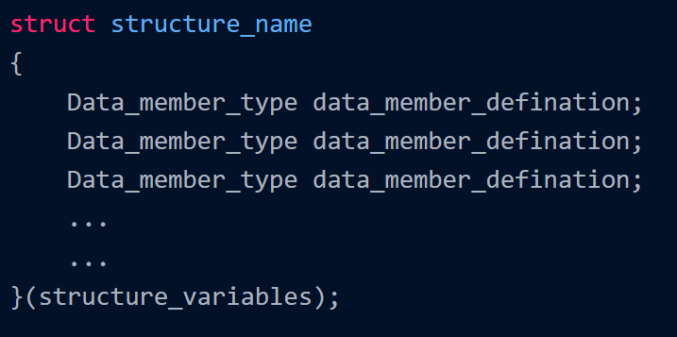
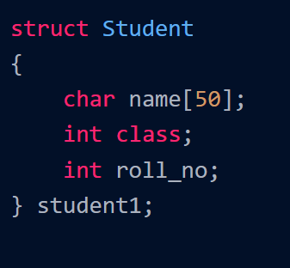
Syntax Example
To create a structure in C, the struct keyword is used followed by the tag name of the structure.
Then the body of the structure is defined, in which the required data members (primitive or user-defined data types) are added.

Slide 5
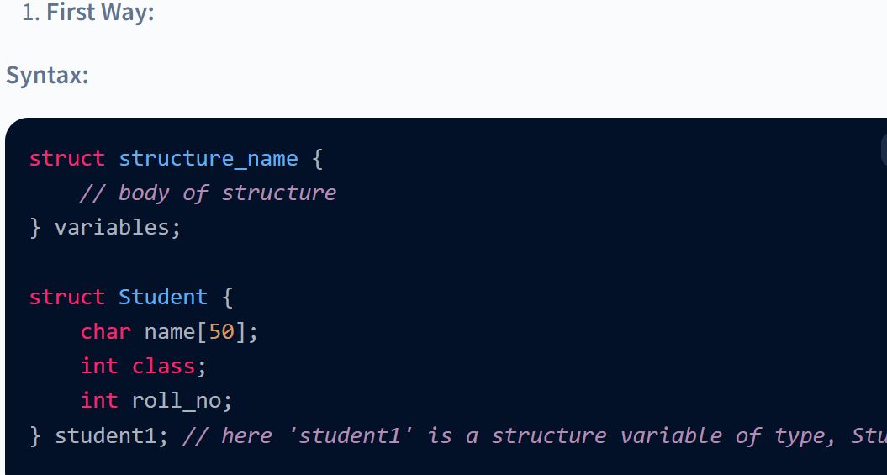
How to Declare Structure Variables?
There are two ways to declare variables for structure in C language:

Slide 6
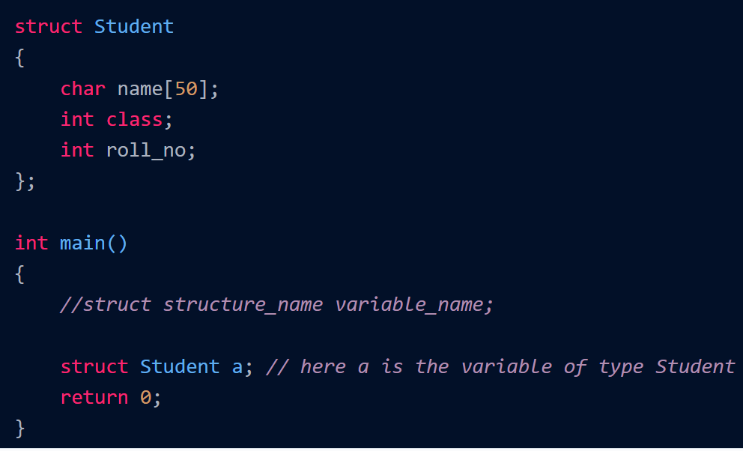
How to Declare Structure Variables?
Second Way:
As we create a structure in C, we have created a user-defined data type. So this data type can be treated as the primitive data type while declaring a variable for that structure.

Slide 7
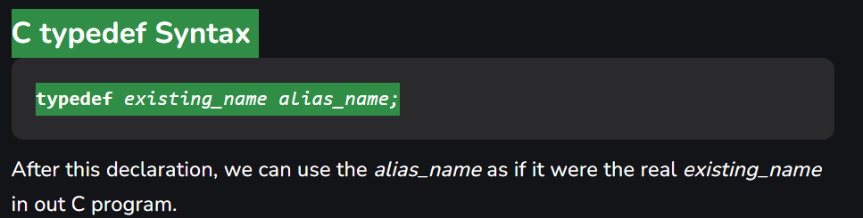
Type def declaration
The typedef is a keyword that is used to provide existing data types with a new name. The C typedef keyword is used to redefine the name of already existing data types.
When names of datatypes become difficult to use in programs, typedef is used with user-defined datatypes, which behave similarly to defining an alias for commands.
Eg :typedef int AIML
AIML N=5

Slide 8
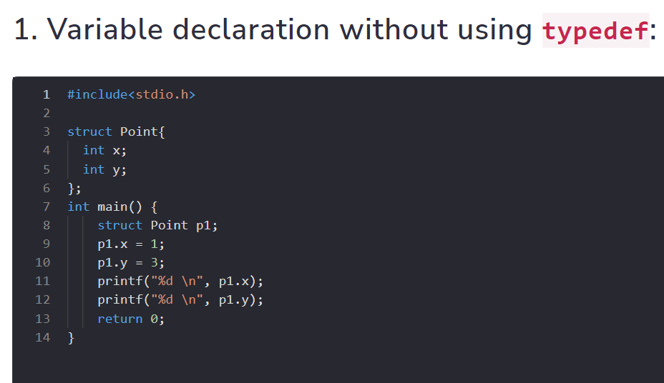
Type def declaration

Slide 9
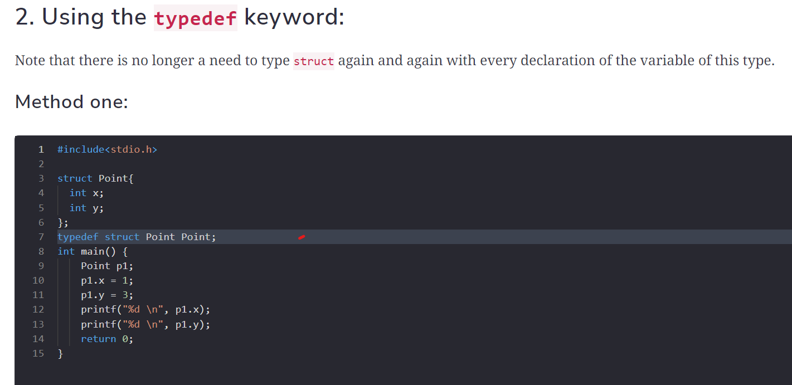
Type def declaration

Slide 10
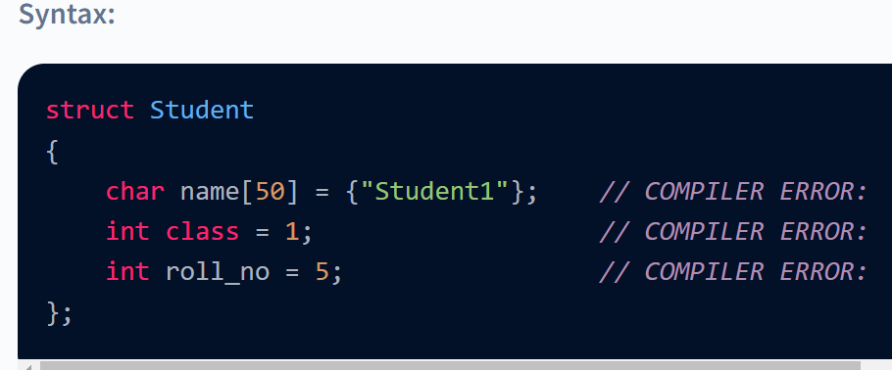
Initialize Structure Members
Initializing a structure member means assigning values to the structure members according to their respective data types.
But declaration doesn't allocate memory for the structure. When we declare a variable for a structure, only then is the memory allocated to that structure variable.
Hence, assigning value to something that doesn't have memory is the same as serving food without a plate, which isn't a good idea! In short, structure members cannot be initialized during the declaration. For example:

Slide 11
Initialize Structure Members
There are three ways to initialize structure members:
Using dot '.' operator
Using curly braces ‘{}’
Designated initializers

Slide 12
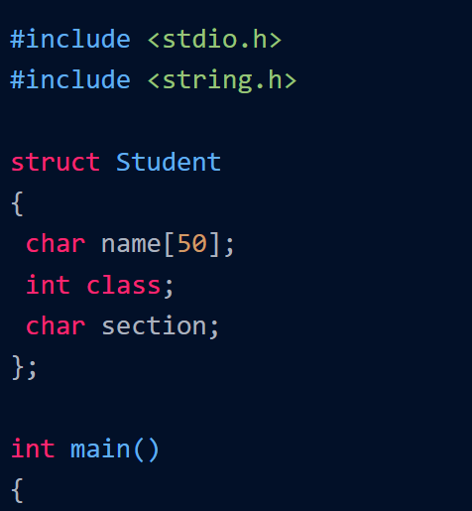
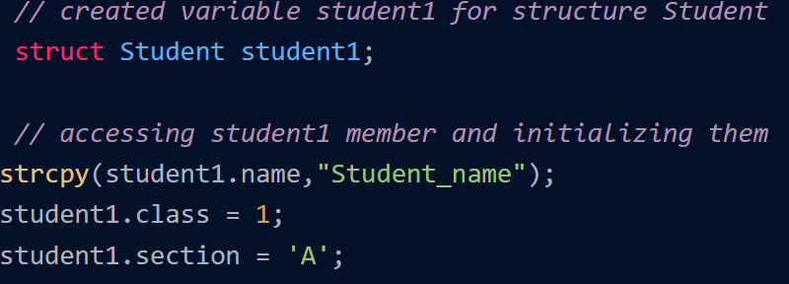
Initialize Structure Members – Using dot(.) Operator
Using the dot (.) operator, we can access any structure member and then initialize or assign its value according to its data type.
Syntax:
struct structure_name variable_name
variable_name.member = value;

Slide 13
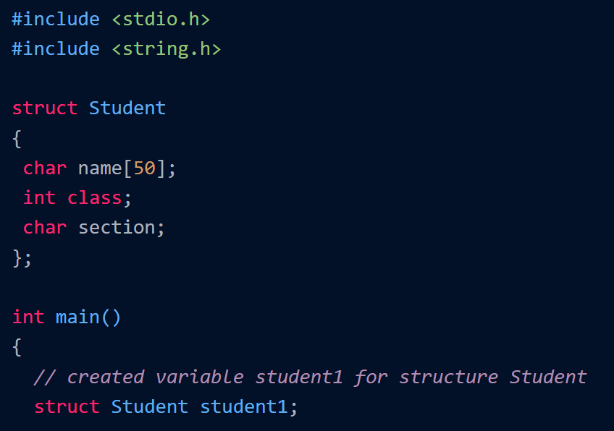
Using curly braces ‘{}’
If we want to initialize all the members during the structure variable declaration, we can declare using curly braces.
Syntax:
struct stucture_name v1 = {value, value, value, ..};

Slide 14
Access Structure Members – Using dot(.) Operator
Using the dot (.) operator, we can access any structure member and then initialize or assign its value according to its data type.
Syntax:
struct structure_name variable_name
variable_name.member = value;

Slide 15
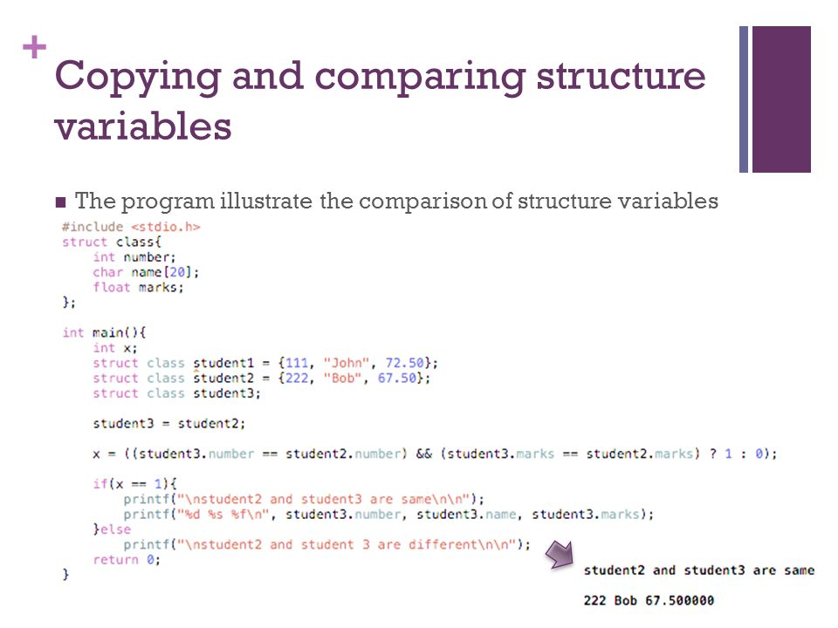
We can assign structure to another structure of same type.
Two variables of the same structure type can be copied the same way as ordinary variables. If b1 and b2 are two book variables, then the following statements are valid:
b1 = b2; b2 = b1

Slide 16
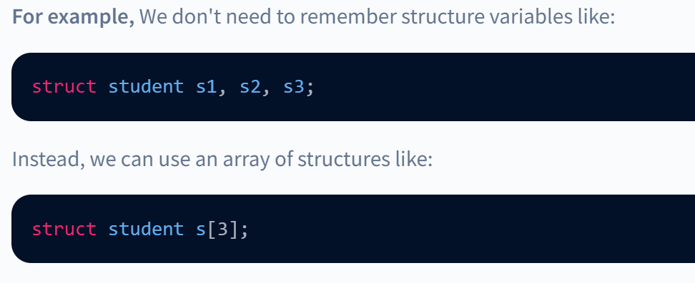
Array of Structures
The array of structures can also be described as a collection of structure variables.
The main advantage of an array is we can represent multiple values with a single variable. So the reusability of code improves; also, readability is increased.
If there is no array of structures, we need to store many values in multiple structure variables, which is redundant

Slide 17
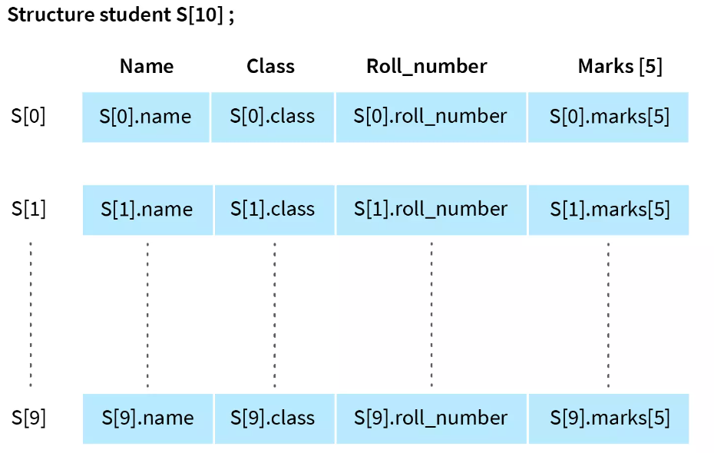
Array of Structures- Example
S is array of structure student having size 10 which means it could store information of 10 different variables of type student.
So we don't need to take 10 different variables instead we could use array of structure student.

Slide 18
Structures and Functions
Structures can be passed as arguments to the functions. This can be done in three ways. They are,
Passing the members of the structures as an argument.
Passing the entire structure as an argument.
Passing the address of the structure as arguments.

Slide 19
Passing the Induvial Members
The dot (.) operator is used to access the individual members of the structure and pass them to the function.
Eg: Let us create a structure to hold the details of a student, such as the name of the student, roll number, and marks, and print out just the roll number and marks using a function. Passing the entire structure to the function is unnecessary when we want to print only a few structure members

Slide 20
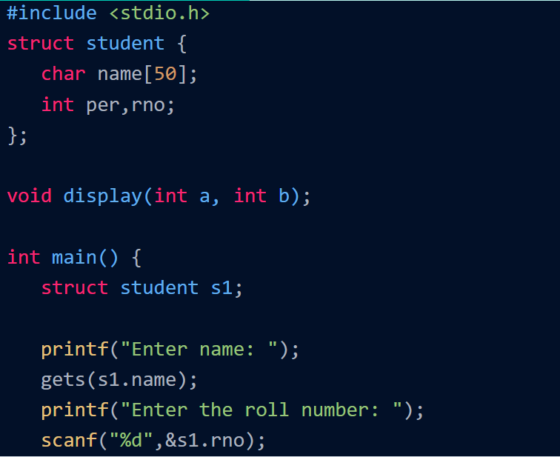
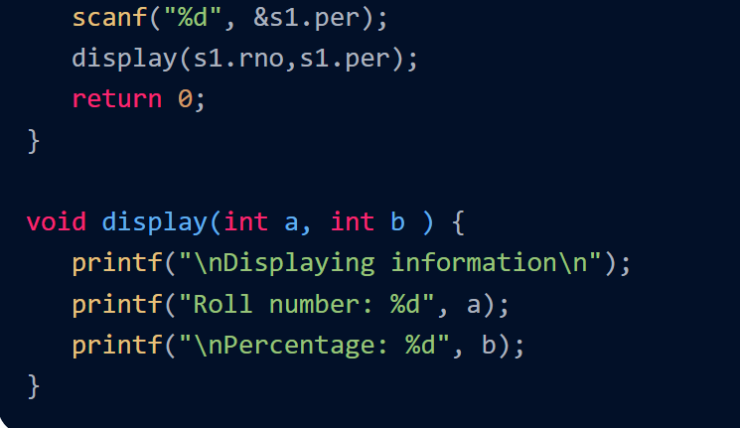
Passing the Induvial Members
we created a structure to hold the name, roll number, and percentage of the student.
The input from the user is stored in the structure. A function named display() is created, which takes the roll number and the percentage of the student as the parameter.
Using the dot (.) operator, we accessed the member of the structure and passed it to the function.

Slide 21
Passing the Entire Structure
You can pass a structure variable to a function as argument like we pass any other variable to a function.
Structure variable is passed using call by value.(Copy of the Each Member is made)
Instead of writing the members in display function, write the structure name in the pervious example.

Slide 22
Passing the Structure through Pointers
Passing the parameter as a value will make a copy of the structure variable, passing it to the function.
Imagine we have a structure with a huge number of structure members. Making a copy of all the members and passing it to the function takes a lot of time and consumes a lot of memory.
To overcome this problem, we can pass the address of the structure.
Pointers are the variables that hold the address of other variables. We can use pointers to pass the structure by reference

Slide 23
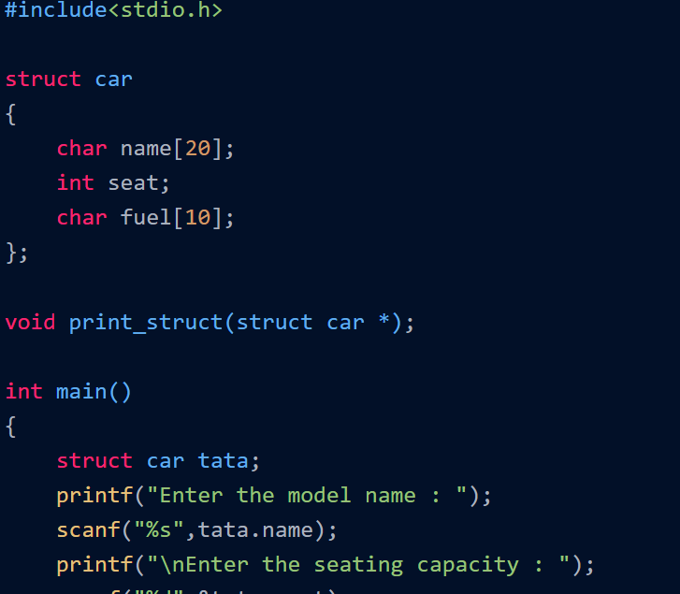
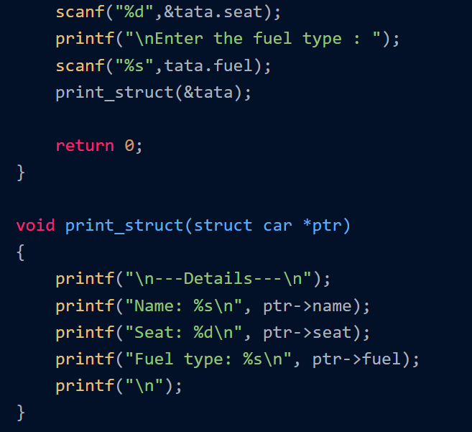
structure named car and a function named print_struct() are defined. The structure stores the model name, seating capacity, and the fuel type of the vehicle.
In the main() function, we created a structure variable named tata and stored the values. Later the address of the structure is passed into the print_struct() function, which prints the details entered by the user.
The address is passed using the address operator ampersand (&). To access the pointer members, we use the arrow operator -> operator.

Slide 24
Passing the Structure through Pointers
Passing the parameter as a value will make a copy of the structure variable, passing it to the function.
Imagine we have a structure with a huge number of structure members. Making a copy of all the members and passing it to the function takes a lot of time and consumes a lot of memory.
To overcome this problem, we can pass the address of the structure.
Pointers are the variables that hold the address of other variables. We can use pointers to pass the structure by reference

